Slide 1
Cosmology with large-scale structures
Part 1/2 : Observations and Mocks
Anand Raichoor
Jiaxi Yu
Cheng Zhao

Slide 2
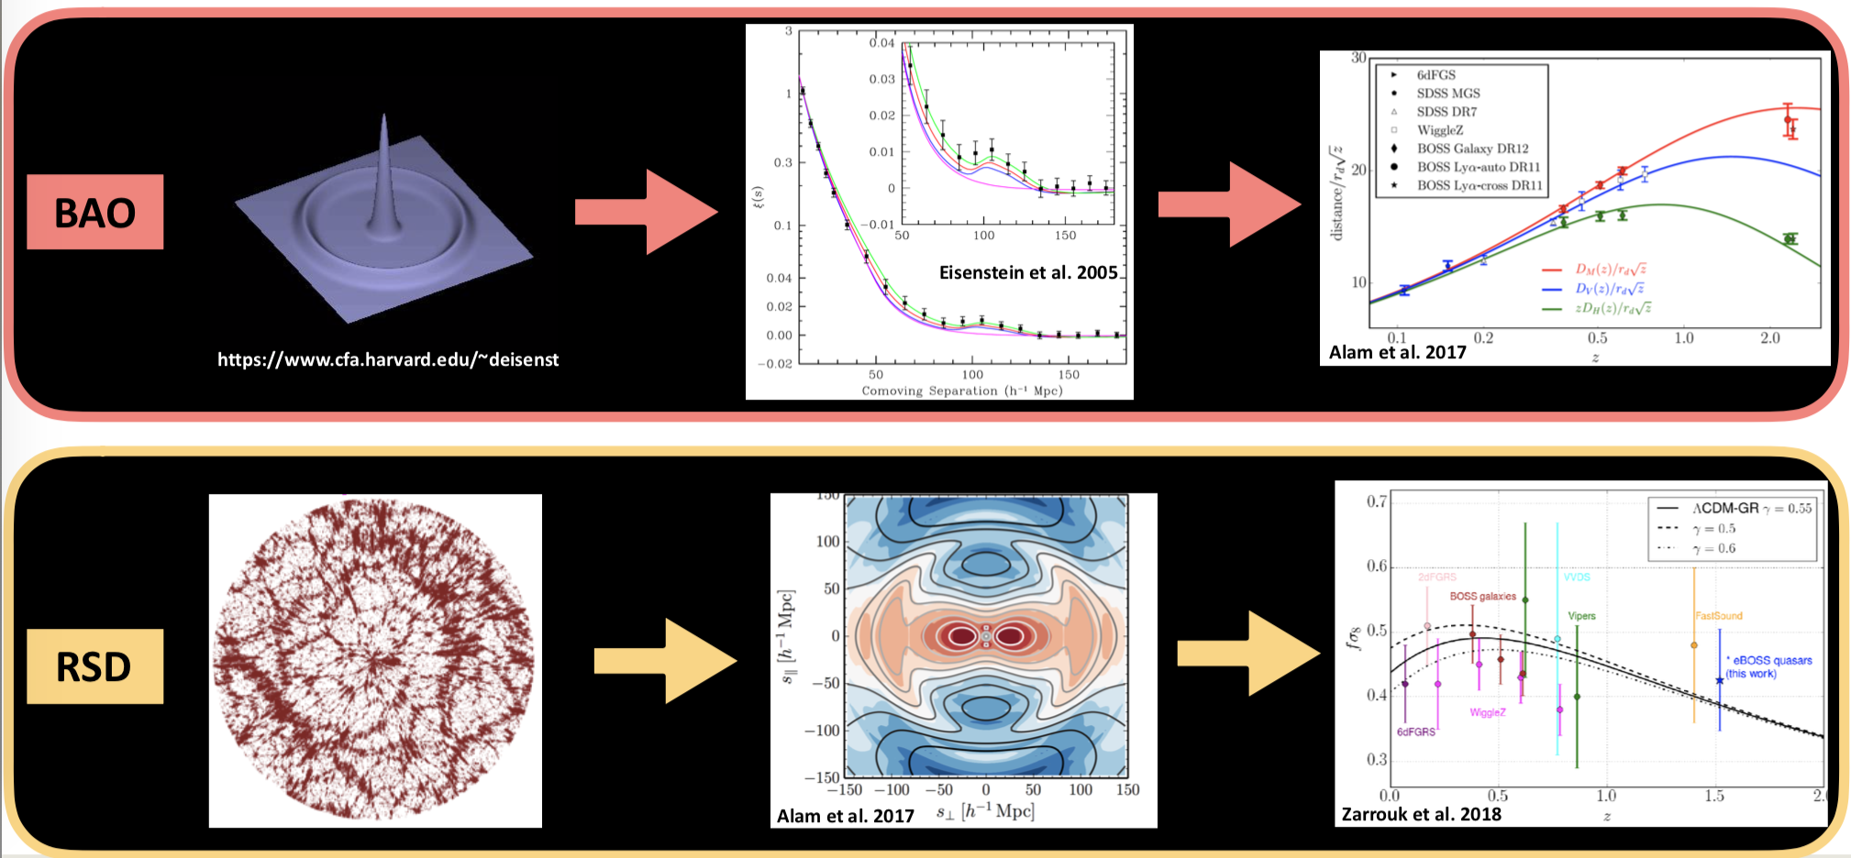
Anand Raichoor
Massive spectroscopic surveys
Main science goals:
Main probes:
Universe geometry with BAO (redshift-distance relation)
Growth of structures and Test of General Relativity with RSD
Other probes:
Neutrino masses
cross-correlation with CMB/lensing surveys
And lots of data for other science!

Slide 3
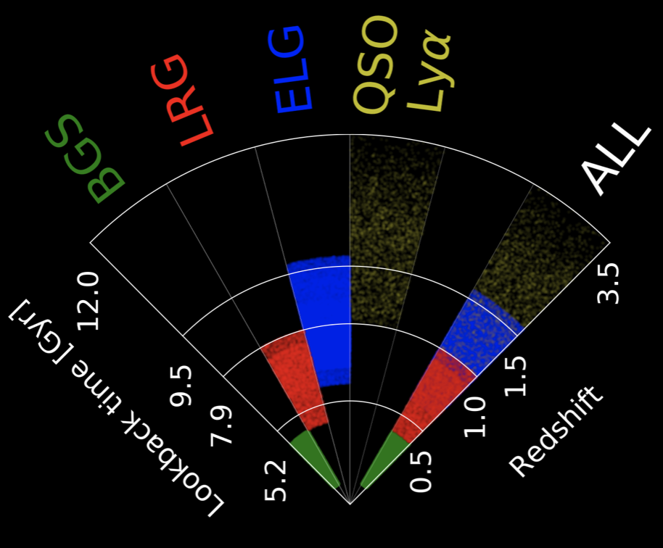
Spectroscopic redshifts
dark matter density field probed with tracers (GAL or QSO)
clustering analysis of GAL/QSO → need the 3D position; (R.A, Dec.) known, need zspec
gather 1e6-1e7 zspec, using massive multiplexing (1000-5000 fibres)
Optmised tracer for each redshift interval
overall constraint: shortest spectroscopic exposure time, to get the more zspec possible
z<0.8 : bright, red galaxies (BGS, LRG) → zspec from absorption features in continuum
z~1 : star-forming galaxies (ELG) → zspec from emission line, mainly [OII] doublet
1<z<2 : quasars (QSO) → zspec from broad emission lines
2<z : Ly-a QSO → using the Ly-a forest (IGM absorption)
Anand Raichoor
Massive spectroscopic surveys

Slide 4
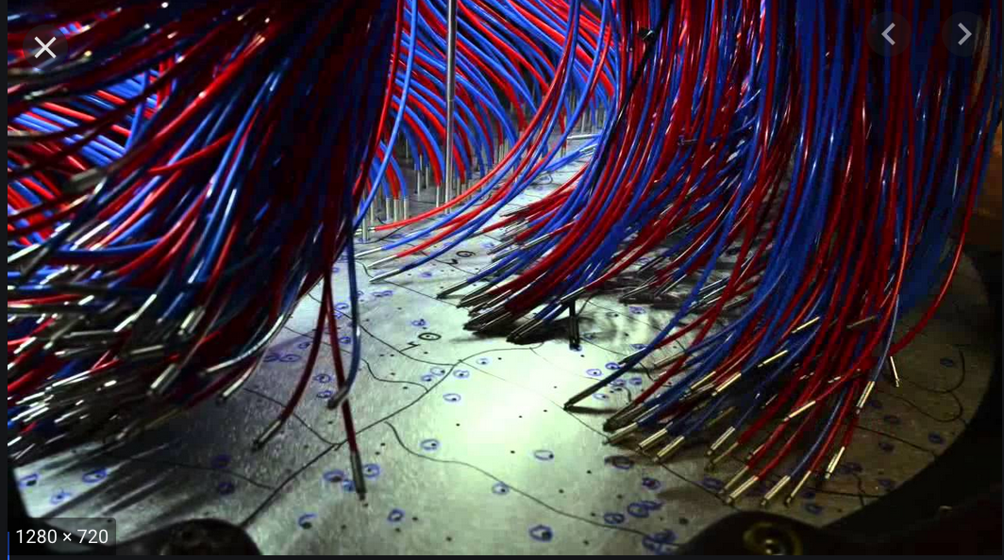
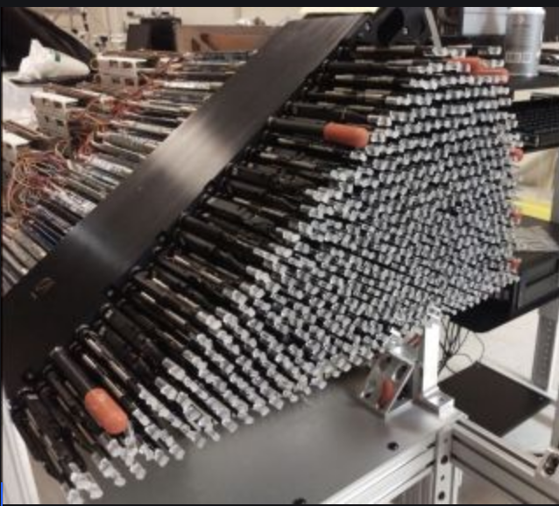
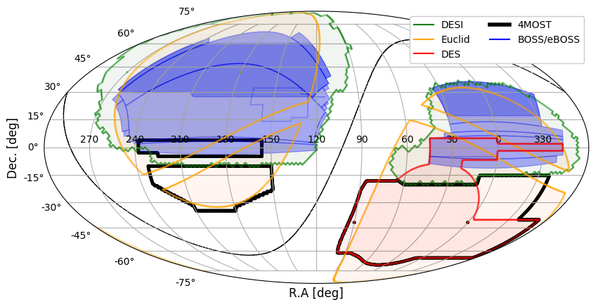
Anand Raichoor
Massive spectroscopic surveys
LASTRO surveys
SDSS BOSS/eBOSS (2008-2019):
2.5m SDSS telescope in New Mexico, USA, 7 deg2 field-of-view
1000 fibres (manually placed in plates, 30min), resolution ~ 2000
BOSS (2008-2014): 1.5M spectra over 10k deg2
eBOSS (2014-2019): 1M spectra over 7.5 deg2
DESI (2020-2025):
4m Mayall telescope in Arizona, USA, 8 deg2 field-of-view
5000 fibres (robotic positioners, 2min), resolution ~ 2000-5500
35M spectra over 14k deg2
4MOST/Cosmology (2022-2027):
4m VISTA telescope in Chile, 4.2 deg2 field-of-view
2400 fibres (tilting spine positioners), resolution ~ 6500,2000
8M spectra over 7.5k deg2
Other surveys
PFS (2020-?):
Subaru telescope
4M spectra over 1.4k deg2 within 0.8<z<2.4
Euclid (2021-2026):
space mission, over 15k deg2
50M spectra within 0.8<z<1.8

Slide 5
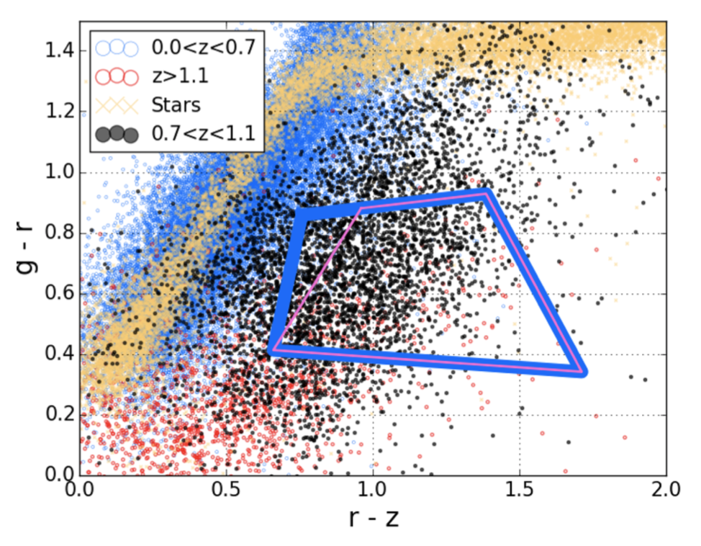
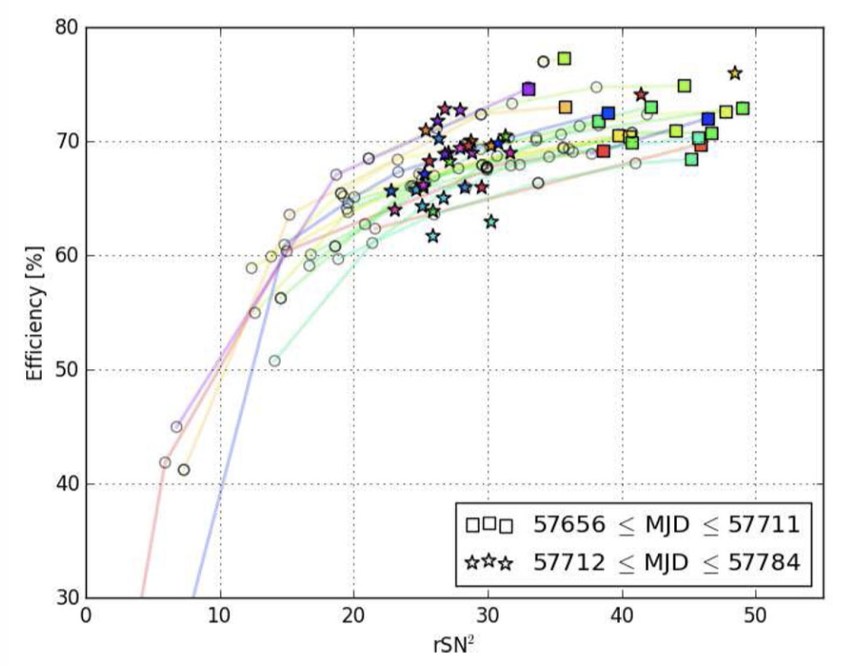
Anand Raichoor
Massive spectroscopic surveys
Steps down to spectroscopic observations (eBOSS/ELG)
Requirements: 240/deg2 targets, ~70% with 0.7<zspec_reliable<1.1
Select targets from imaging: use of DECaLS grz-imaging (DESI imaging: http://legacysurvey.org/)
Define a minimum exposure-quality time, set by pilot observations

Slide 6
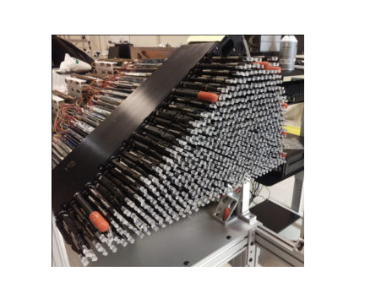
Jiaxi Yu
Spectroscopic Data Processing
Known (RA,DEC)
Redshift z ?
From Spectra
A Spectrograph
A Galaxy/Quasar candidate
(Photograph from https://www.desi.lbl.gov/focal-plane-system/)

Slide 7
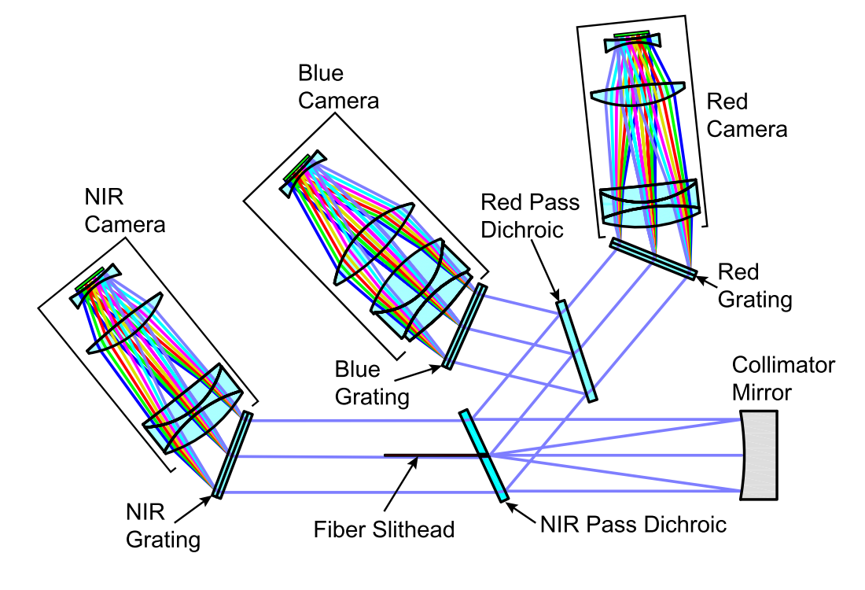
Jiaxi Yu
Spectroscopic Data Processing
Inside A Spectrograph
CCD
CCD
CCD
objects’ 2D images
grating:
“fourier transform”
(Schematic from DESI Collaboration. (2016). DESI Final Design Report Part II : Instrument Design. Fig 5.1)

Slide 8
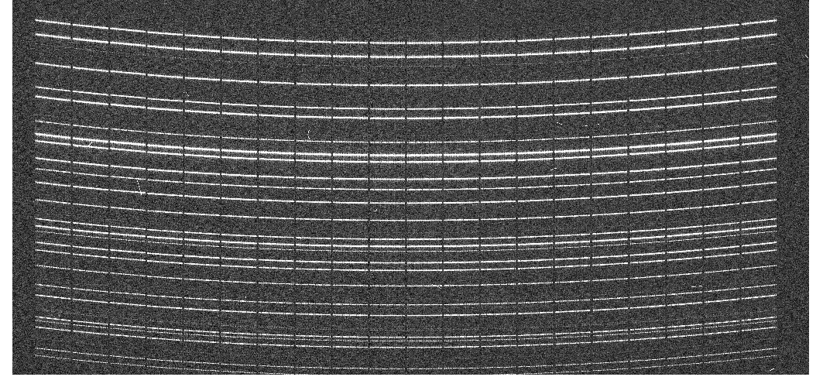
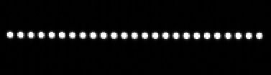
Jiaxi Yu
Spectroscopic Data Processing
A multi-fibre image on CCD
Wavelength Correction
Fiber-Flat Correction
image.dot (transfer matrix)
wavelength
 |  |  | ...
 |  |  | ...
...
Multiple 1D spectra
fibres

Slide 9
Jiaxi Yu
Spectroscopic Data Processing
A multi-fibre image on CCD
Wavelength Correction
Fiber-Flat Correction
image.dot (transfer matrix)
wavelength
 |  |  | ...
 |  |  | ...
...
Multiple 1D spectra
fibres

Slide 10
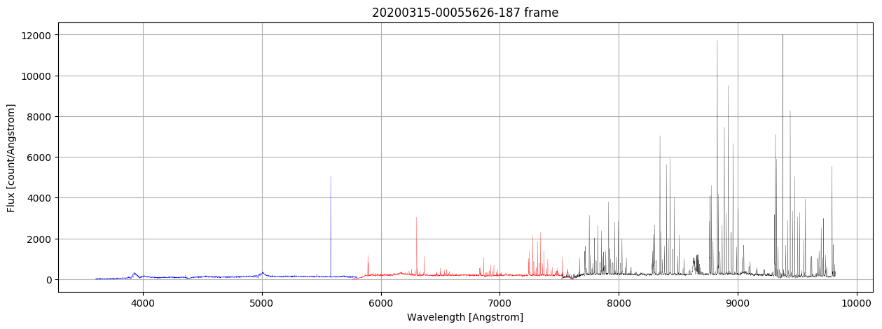
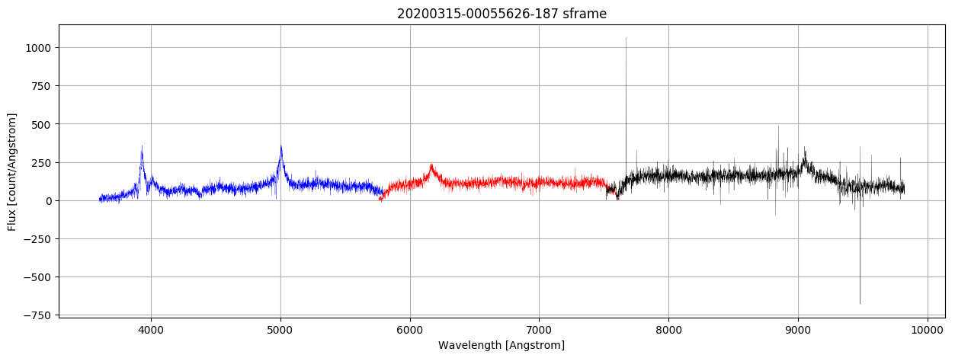
Jiaxi Yu
Spectroscopic Data Processing
A Raw Spectrum
Sky-Subtracted

Slide 11
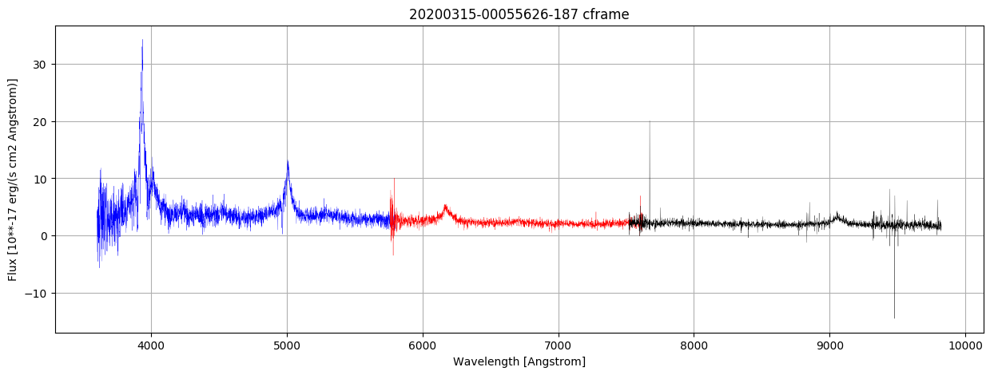
Jiaxi Yu
Spectroscopic Data Processing
A Raw Spectrum
Sky-Subtracted and Flux-Calibrated

Slide 12
Jiaxi Yu
Spectroscopic Data Processing
An Object
Spectrum
Templates Fitting
Redshift Measurement
The object spectrum
Its redshift (RA,DEC known)
Its type: LRG, Quasar, ELG, etc.
millions of objects for the scientific analysis

Slide 13
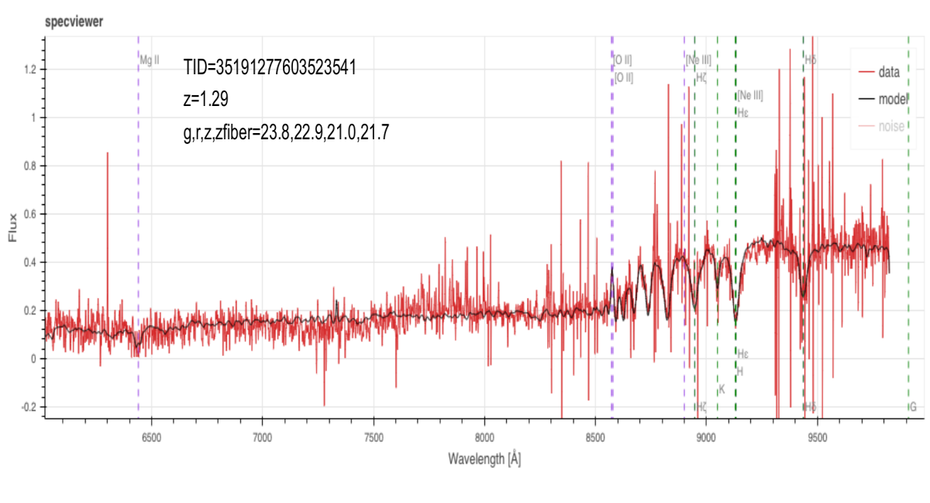
Jiaxi Yu
Spectrum Examples: LRG
Luminous Red Galaxy (LRG)
Figure from Rongpu Zhou’s SV report in DESI collaboration.

Slide 14
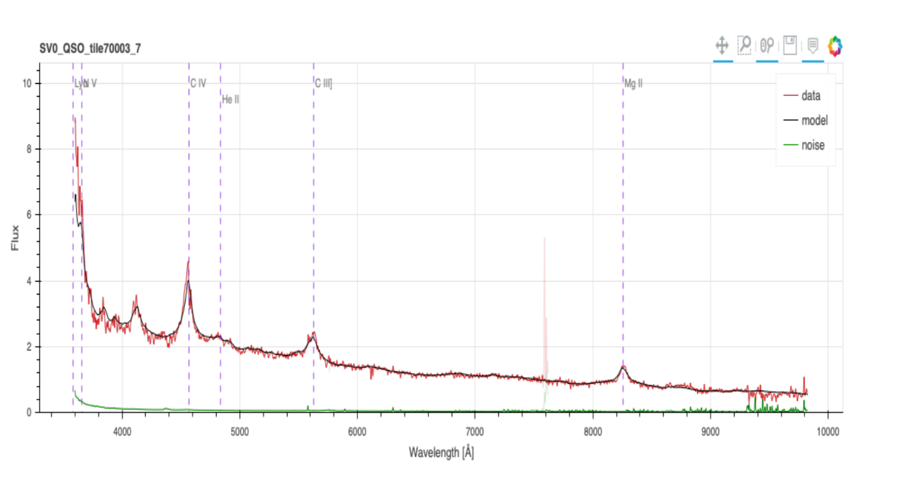
Jiaxi Yu
Spectrum Examples: QSO
Quasar (QSO)
Figure fromChristophe Yeche’s SV report in DESI collaboration.

Slide 15
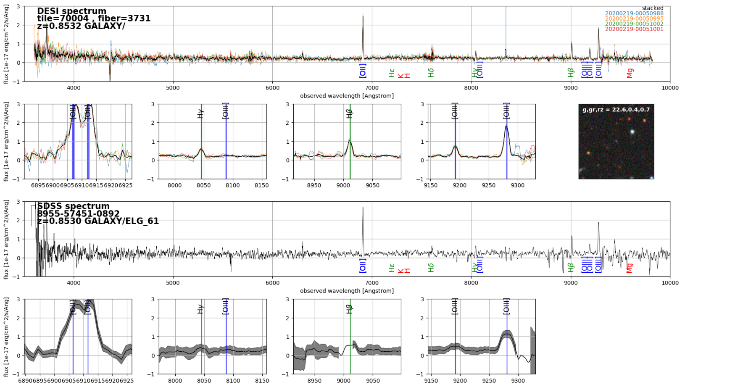
Jiaxi Yu
Spectrum Examples: ELG
DESI
Emission Line Galaxy (ELG)
SDSS
Emission Lines
short exposure => good z quality
Figure from Anand Raichoor’s SV report in DESI collaboration.

Slide 16
Jiaxi Yu
Spectrum Examples: ELG
DESI
Emission Line Galaxy (ELG)
SDSS
DESI: better emission lines?
Due to higher resolution
obtain more obj. with reliable z
Figure from Anand Raichoor’s SV report in DESI collaboration.

Slide 17
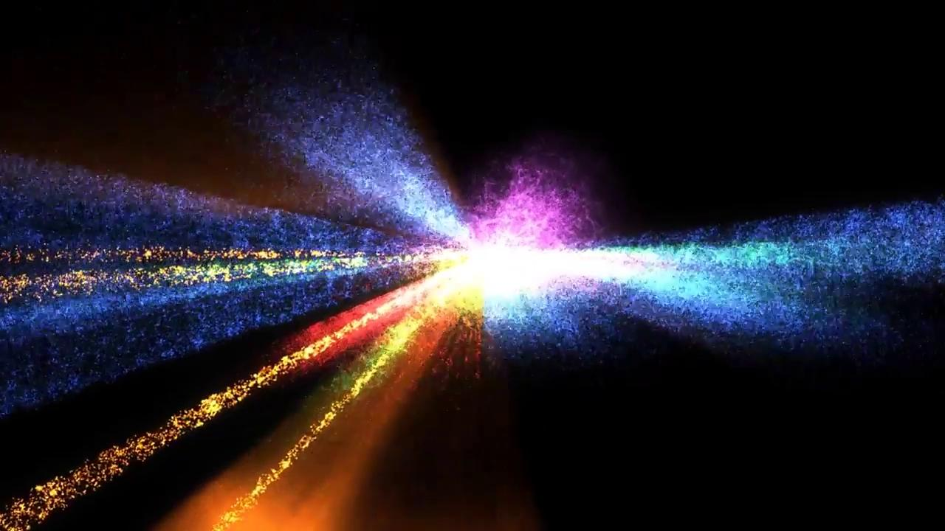

Slide 18
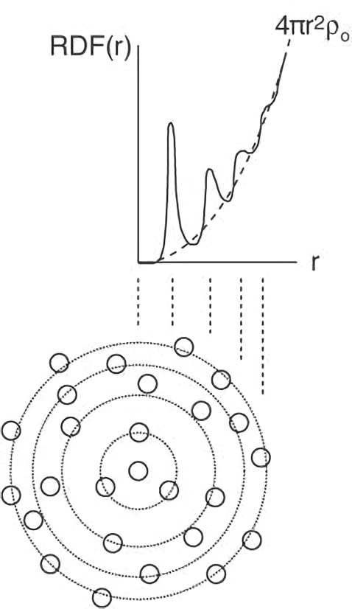
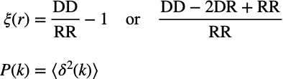
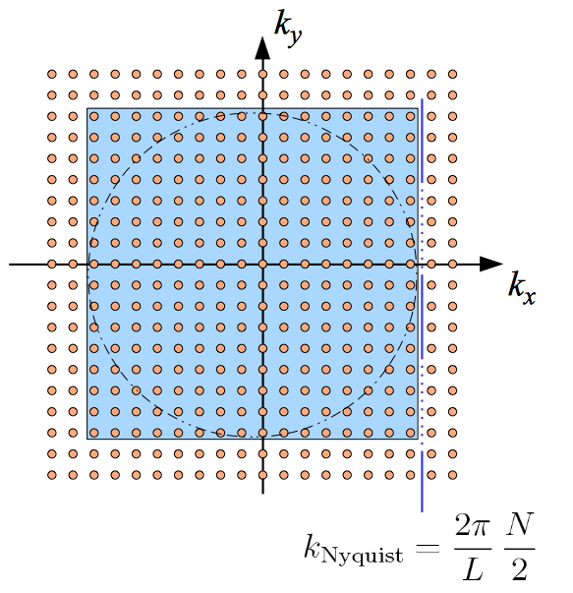
Cheng
Measurement of 2-point correlation function (2PCF) and power spectrum
# of pairs

Slide 19
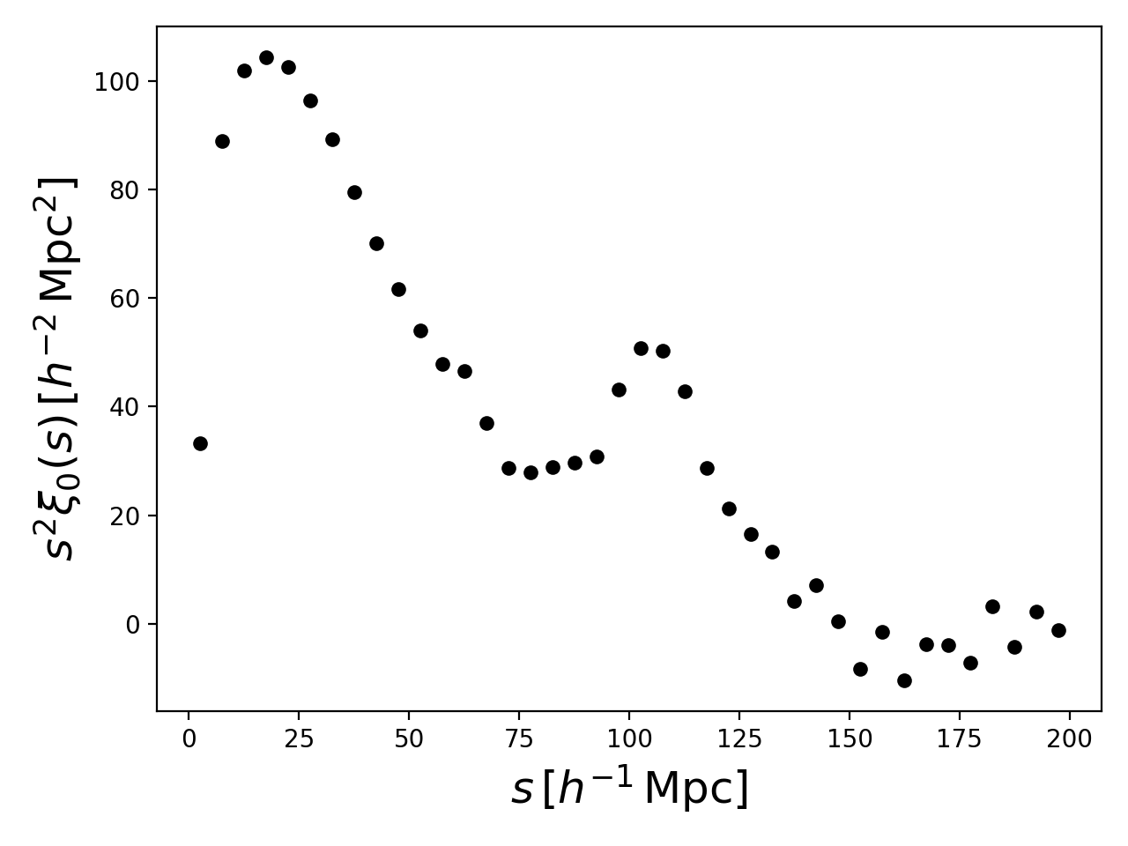
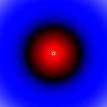
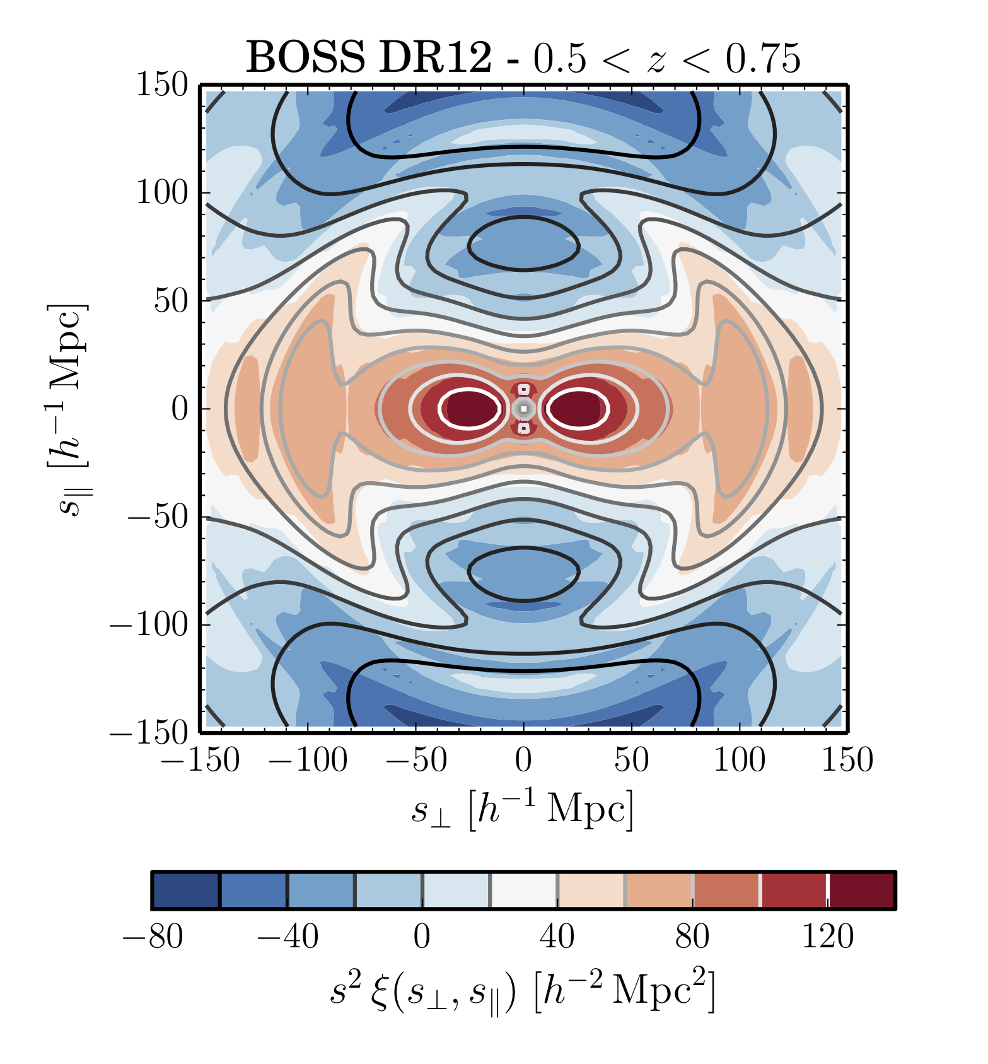
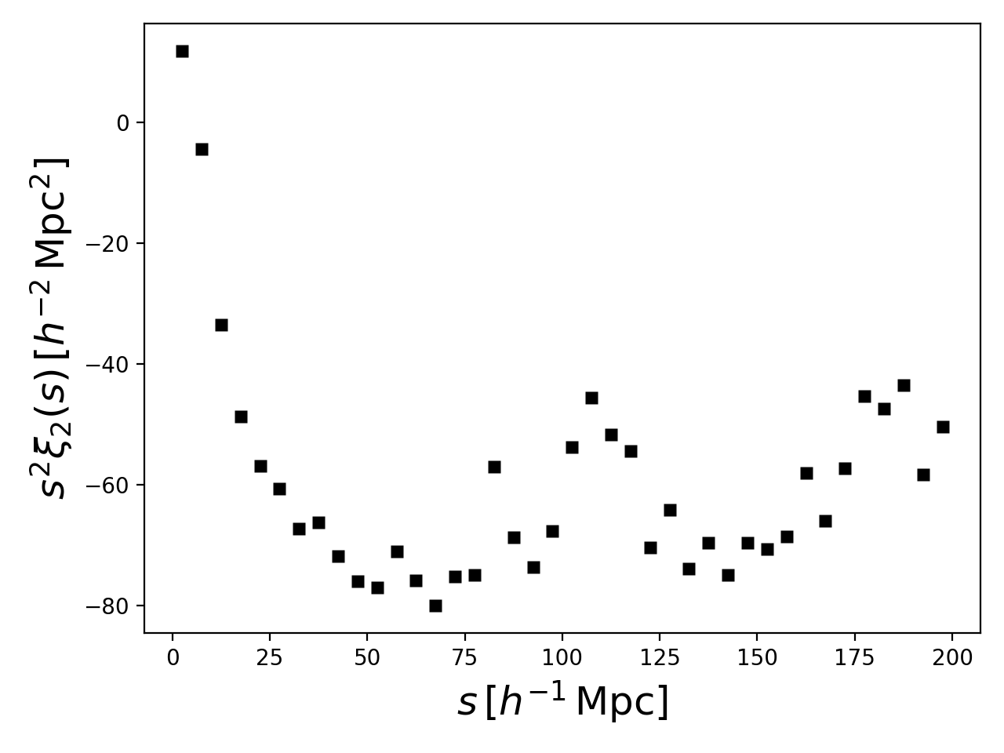


Cheng
2-D 2PCF and multipoles
Legendre
polynomials
line of sight
monopole
quadrupole
Alam+ 2017

Slide 20
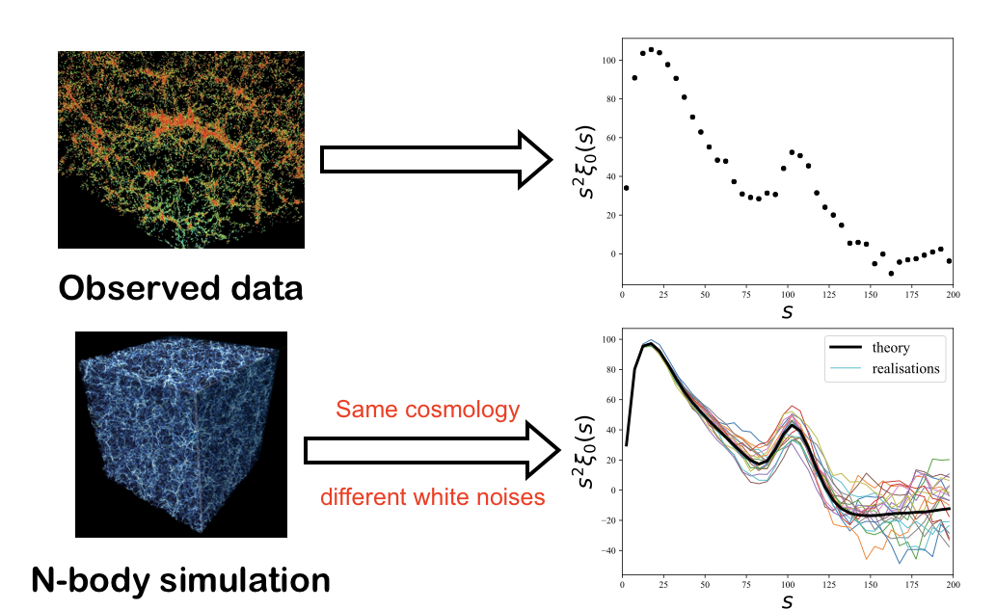
Cheng
Cosmic variance

Slide 21
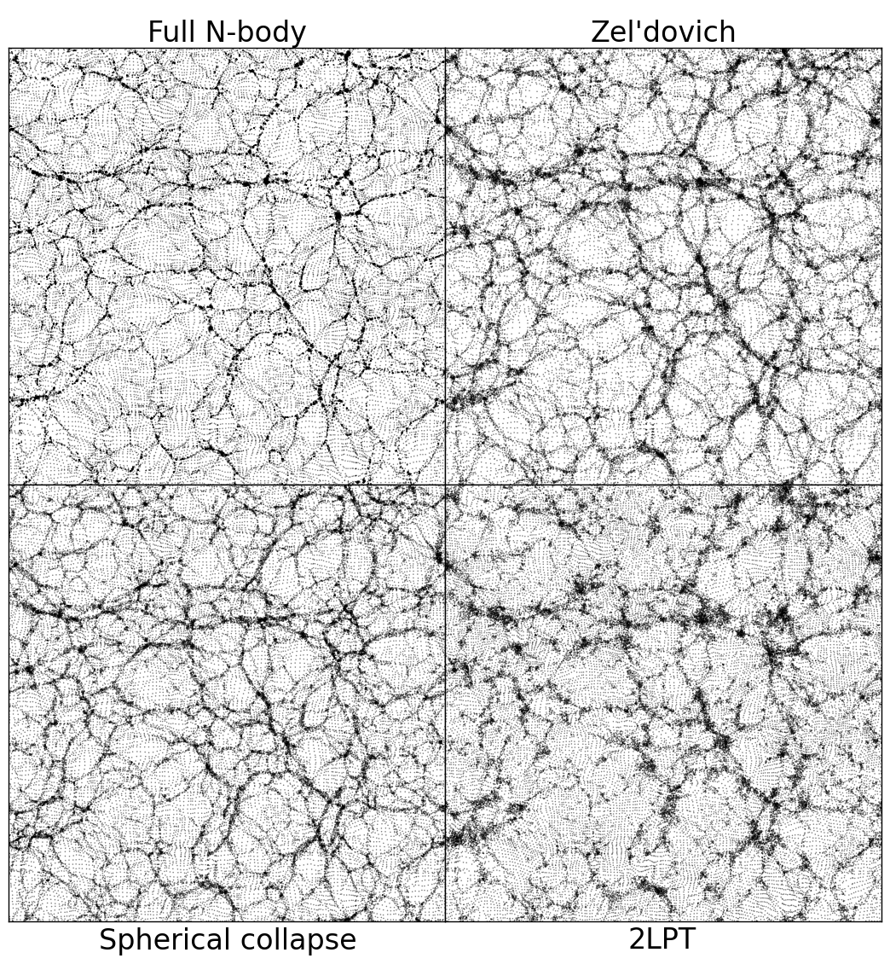
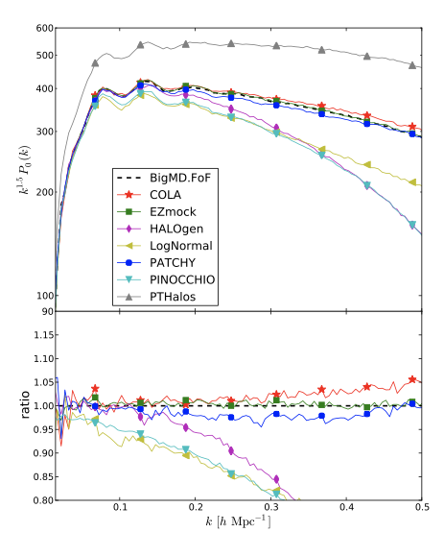
Cheng
Fast (approximate) mock generation
Chuang+ 2015
Neyrinck 2013

Slide 22
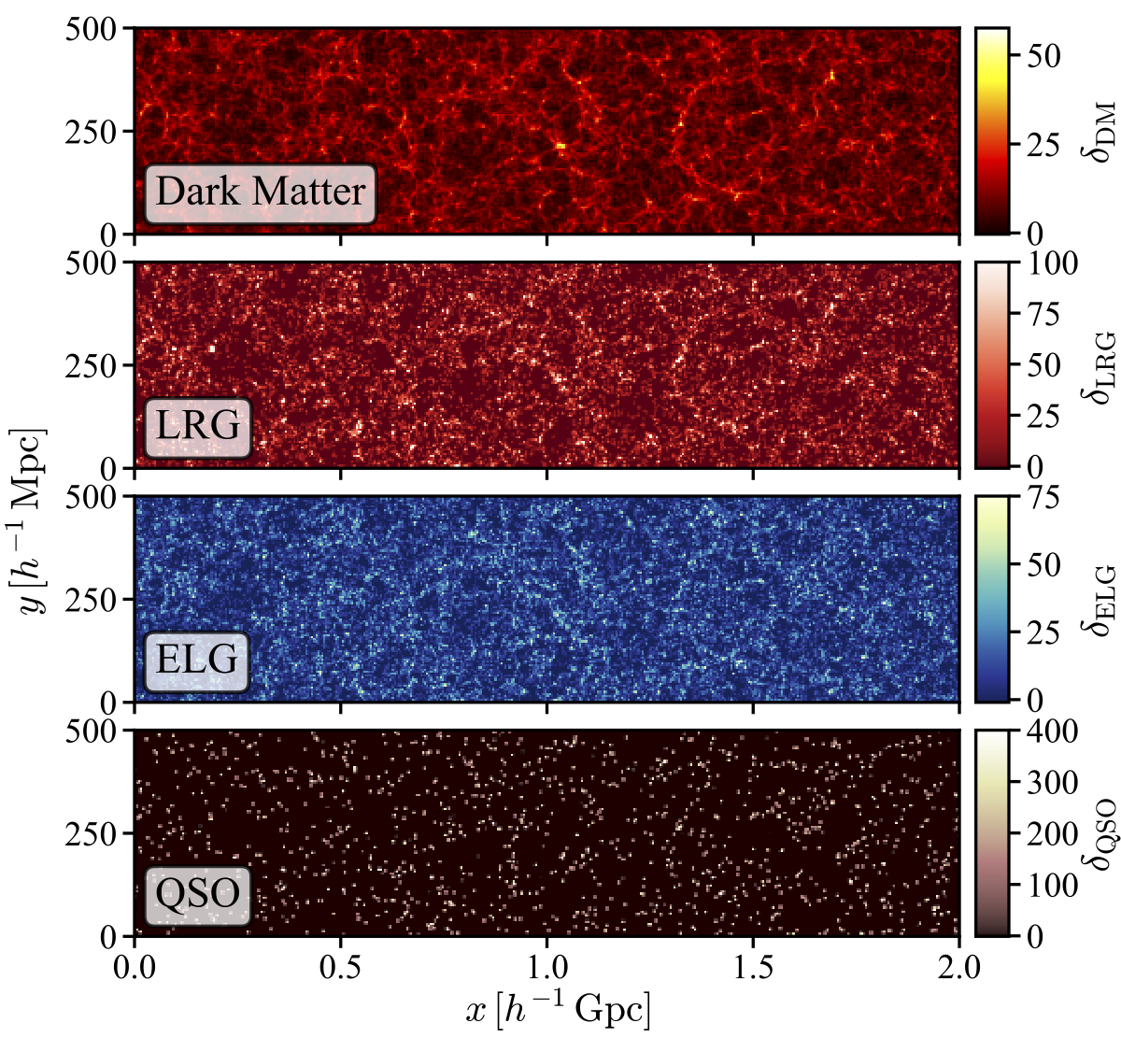
Cheng
Density map of fast mocks

Slide 23
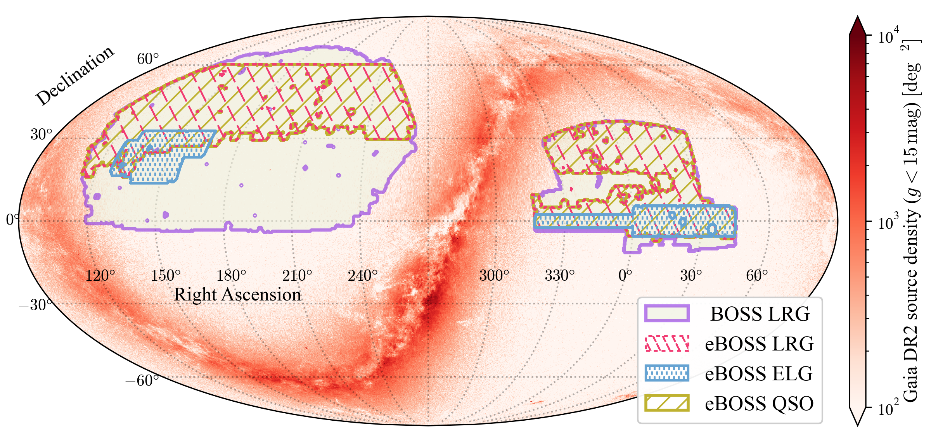
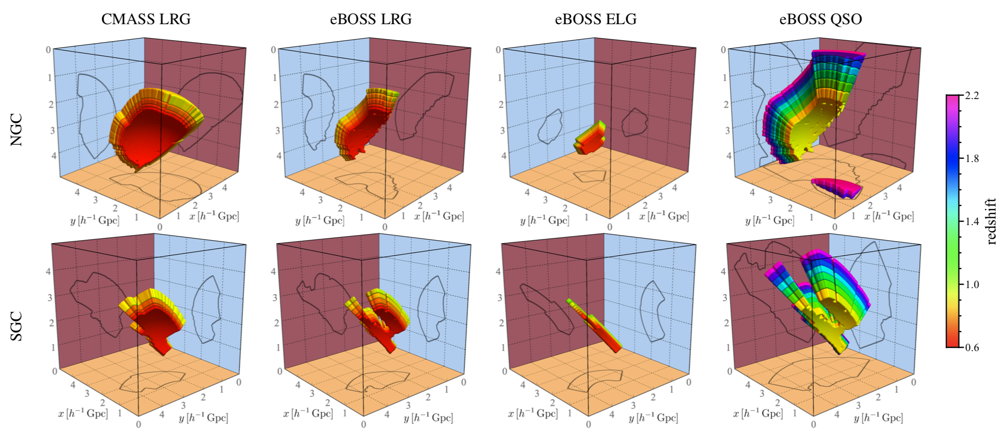
Cheng
Survey geometry mapping
Data
Mock catalogues

Slide 24
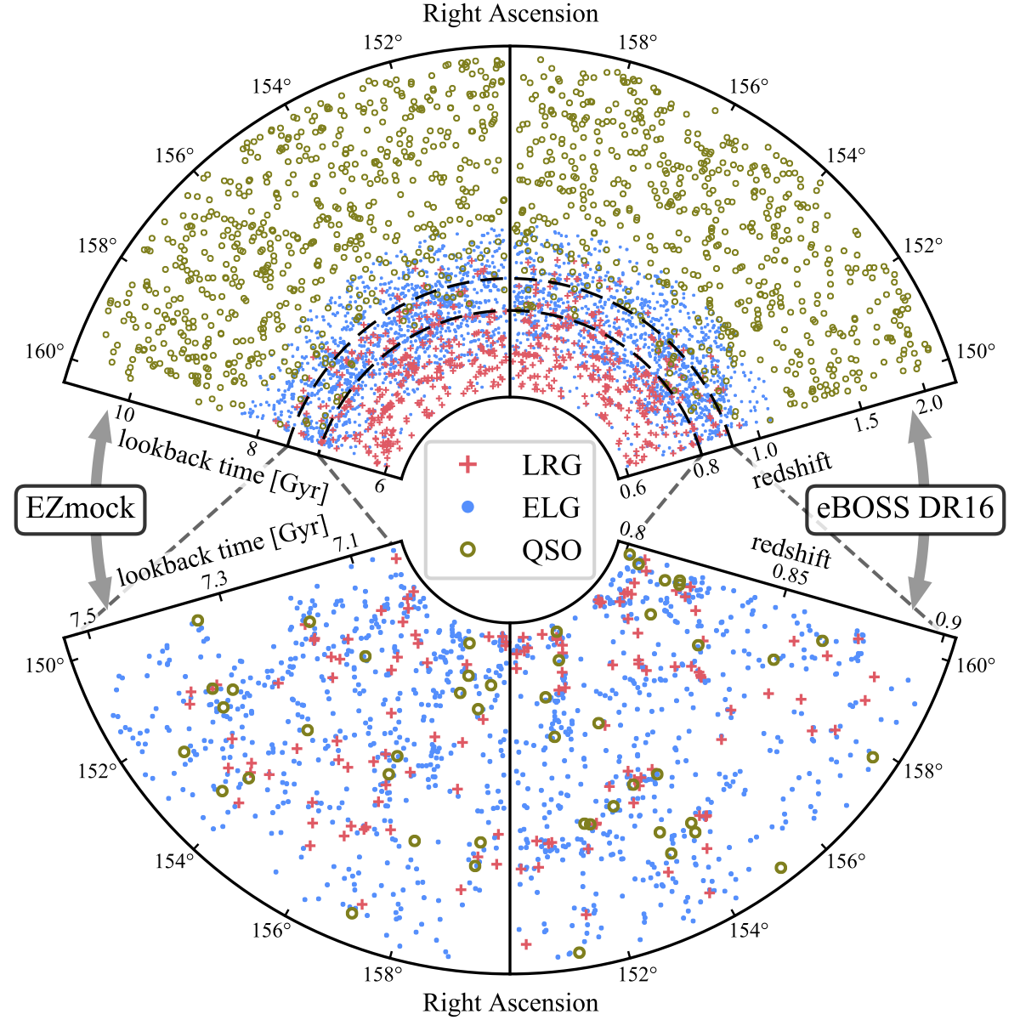
Cheng
Tracer distribution comparison

Slide 25
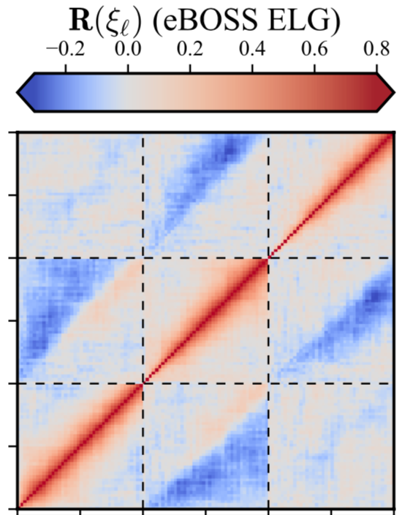
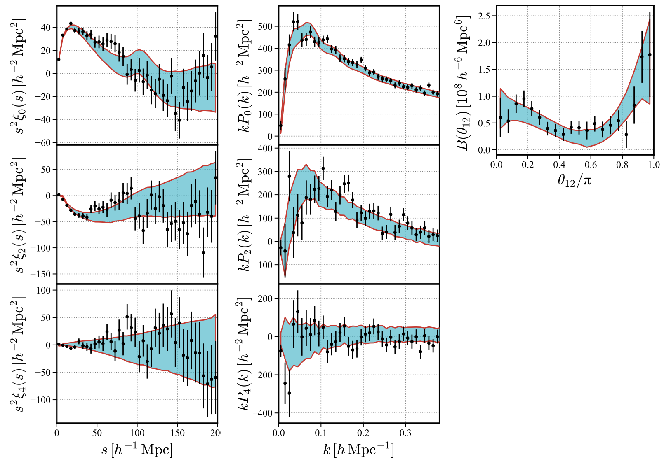
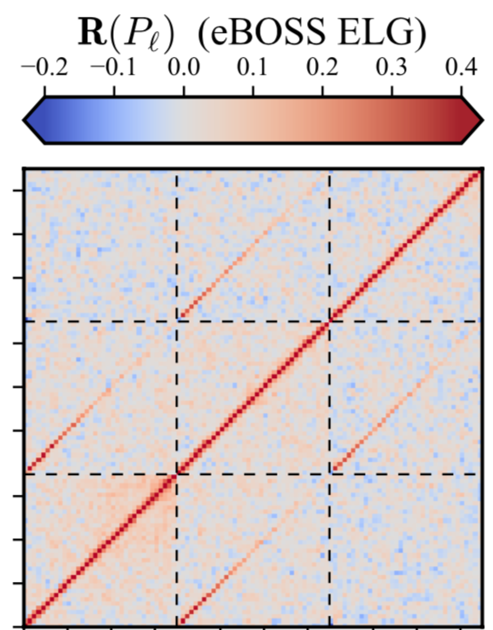
Cheng
Clustering measurements and covariance matrices
2PCF
power spectra

Slide 26
Cosmology with large-scale structures
Next week:
Part 2/2 : Theories and Analysis
Jonathan Blazek
Amélie Tamone
Andrei Variu
Cheng Zhao

Slide 27
Cosmology with large-scale structures
Part 2/2 : Theories and Analysis
Jonathan Blazek
Amélie Tamone
Andrei Variu
Cheng Zhao

Slide 28
Cosmological fields and N-point functions
See jupyter notebook
Jonathan Blazek

Slide 29
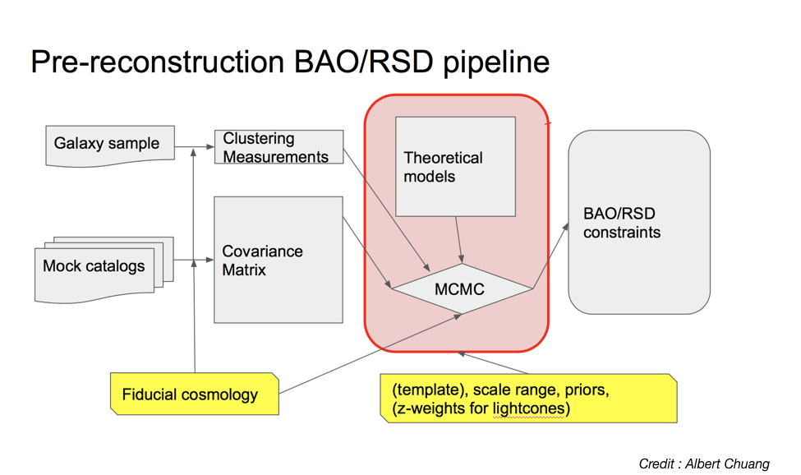
Amélie
Amélie
Large Scale Surveys Standard Analysis

Slide 30
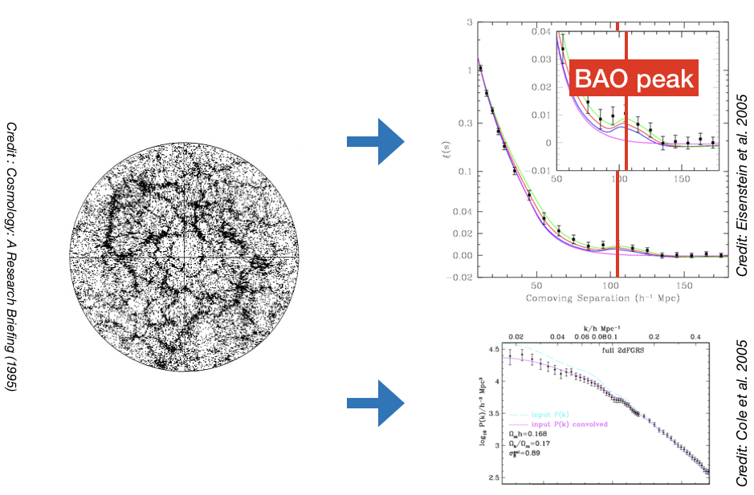
Amélie
Amélie
BAO-only Analysis

Slide 31
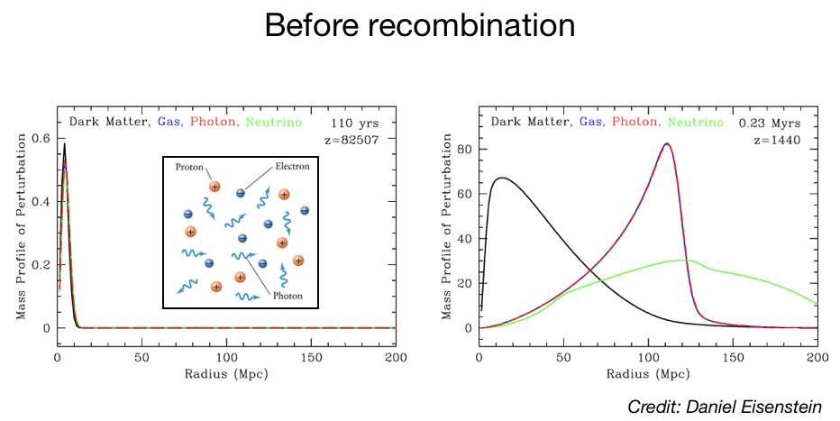
Amélie
Amélie
Baryon Acoustic Oscillations

Slide 32
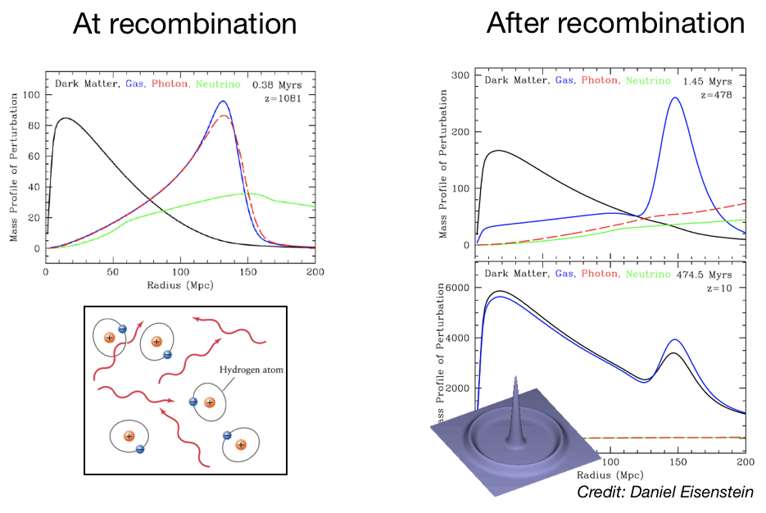
Amélie
Amélie
Baryon Acoustic Oscillations

Slide 33
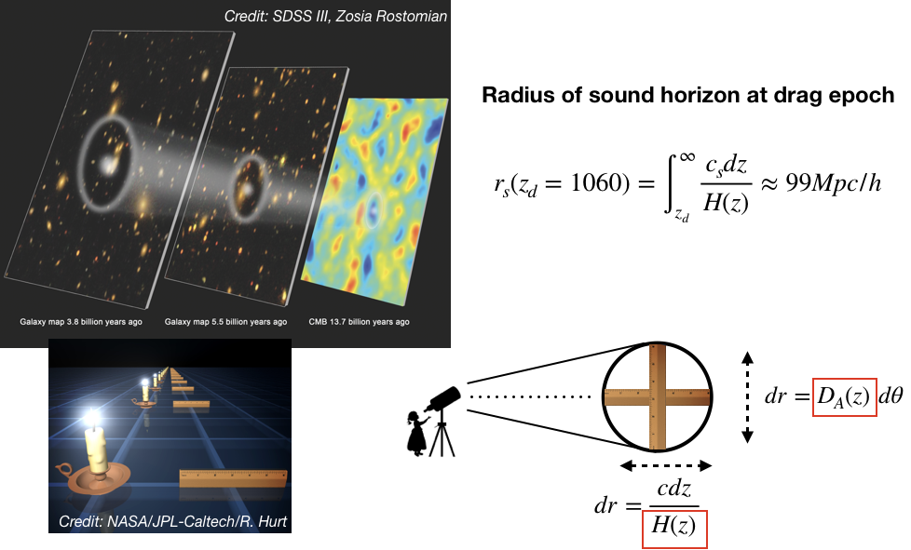
Amélie
Amélie
BAO as a standard ruler

Slide 34
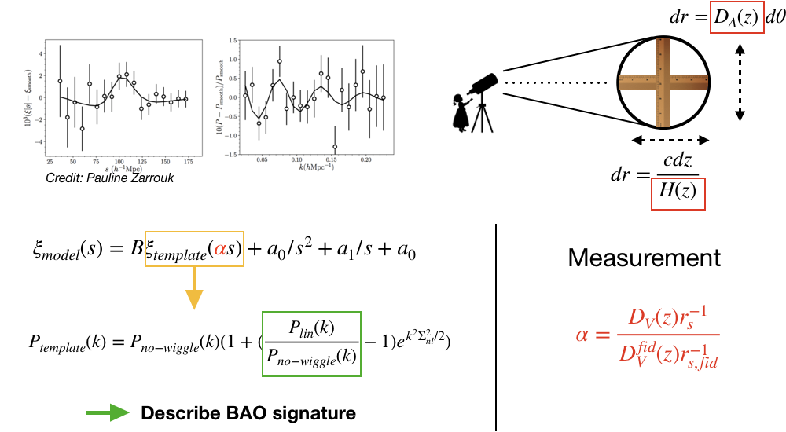
Amélie
Amélie
Modeling BAO-only

Slide 35
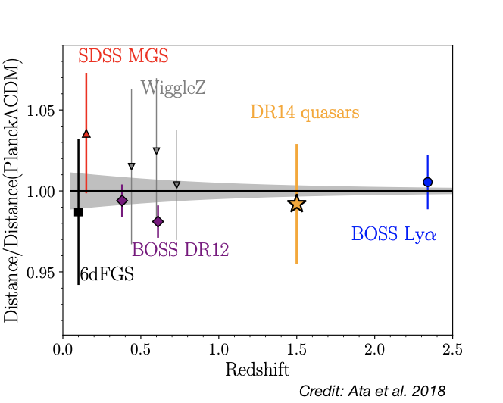
Amélie
Amélie
BAO : LCDM test

Slide 36
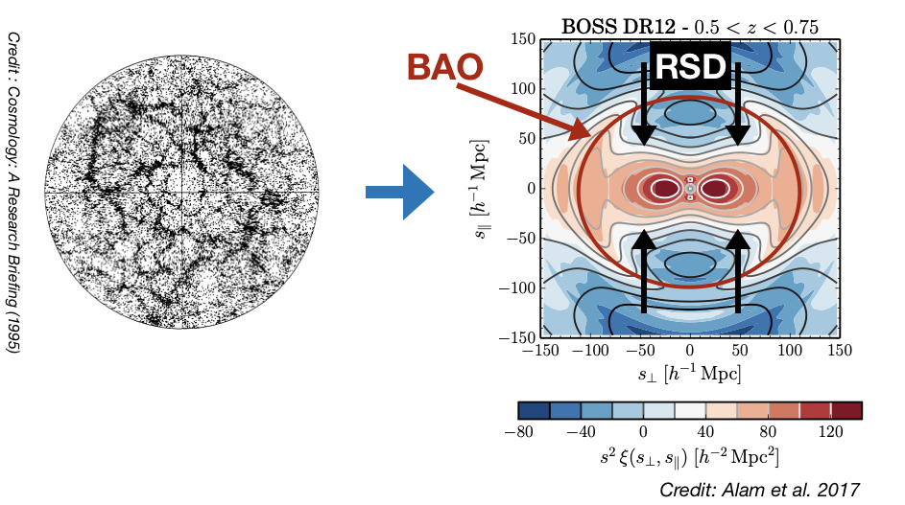
Amélie
Amélie
Full-shape Analysis

Slide 37
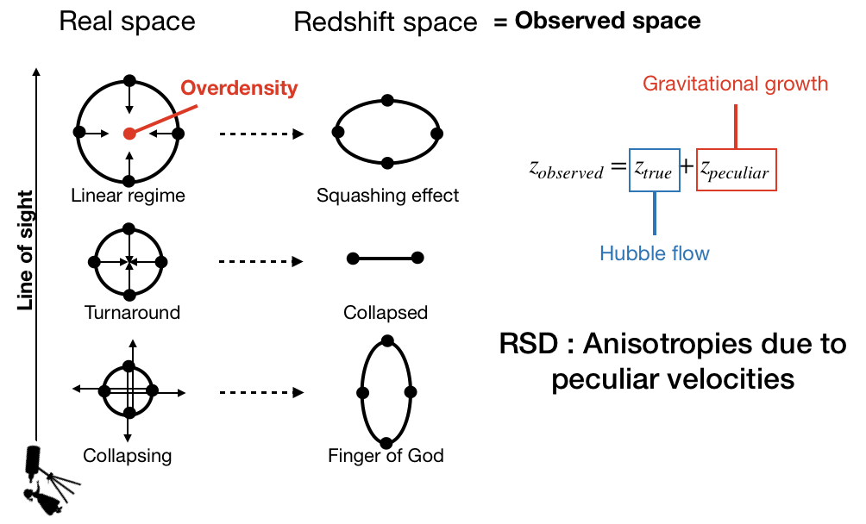
Amélie
Amélie
Redshift Space Distortions

Slide 38
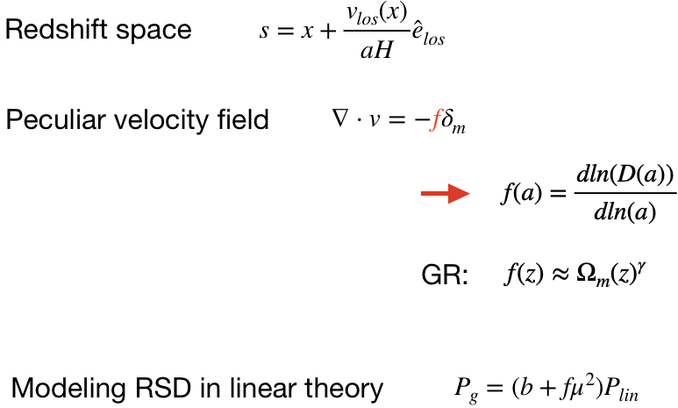
Amélie
Amélie
Growth Rate of Structures

Slide 39
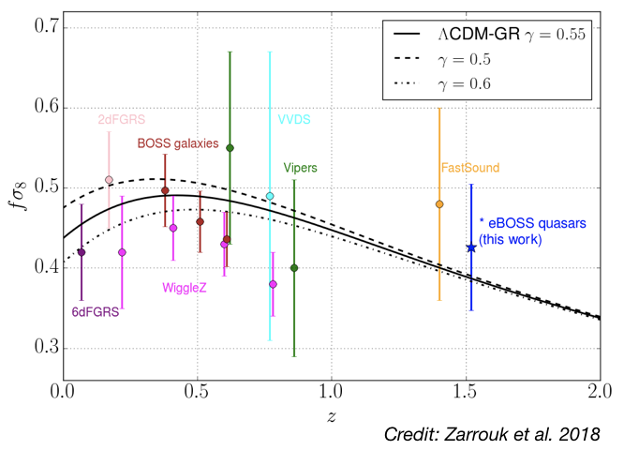
Amélie
Amélie
RSD : General Relativity test

Slide 40
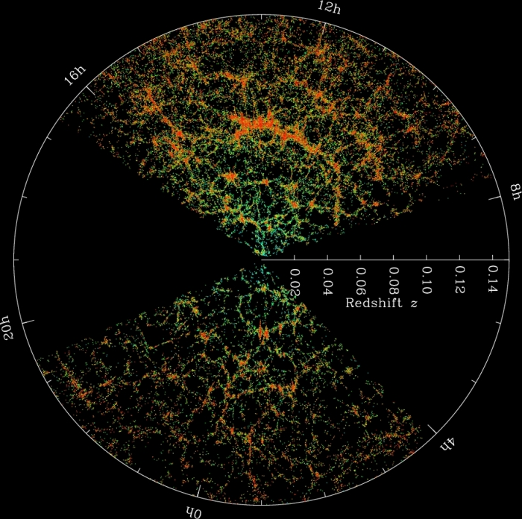
Andrei Variu
Voids

Slide 41
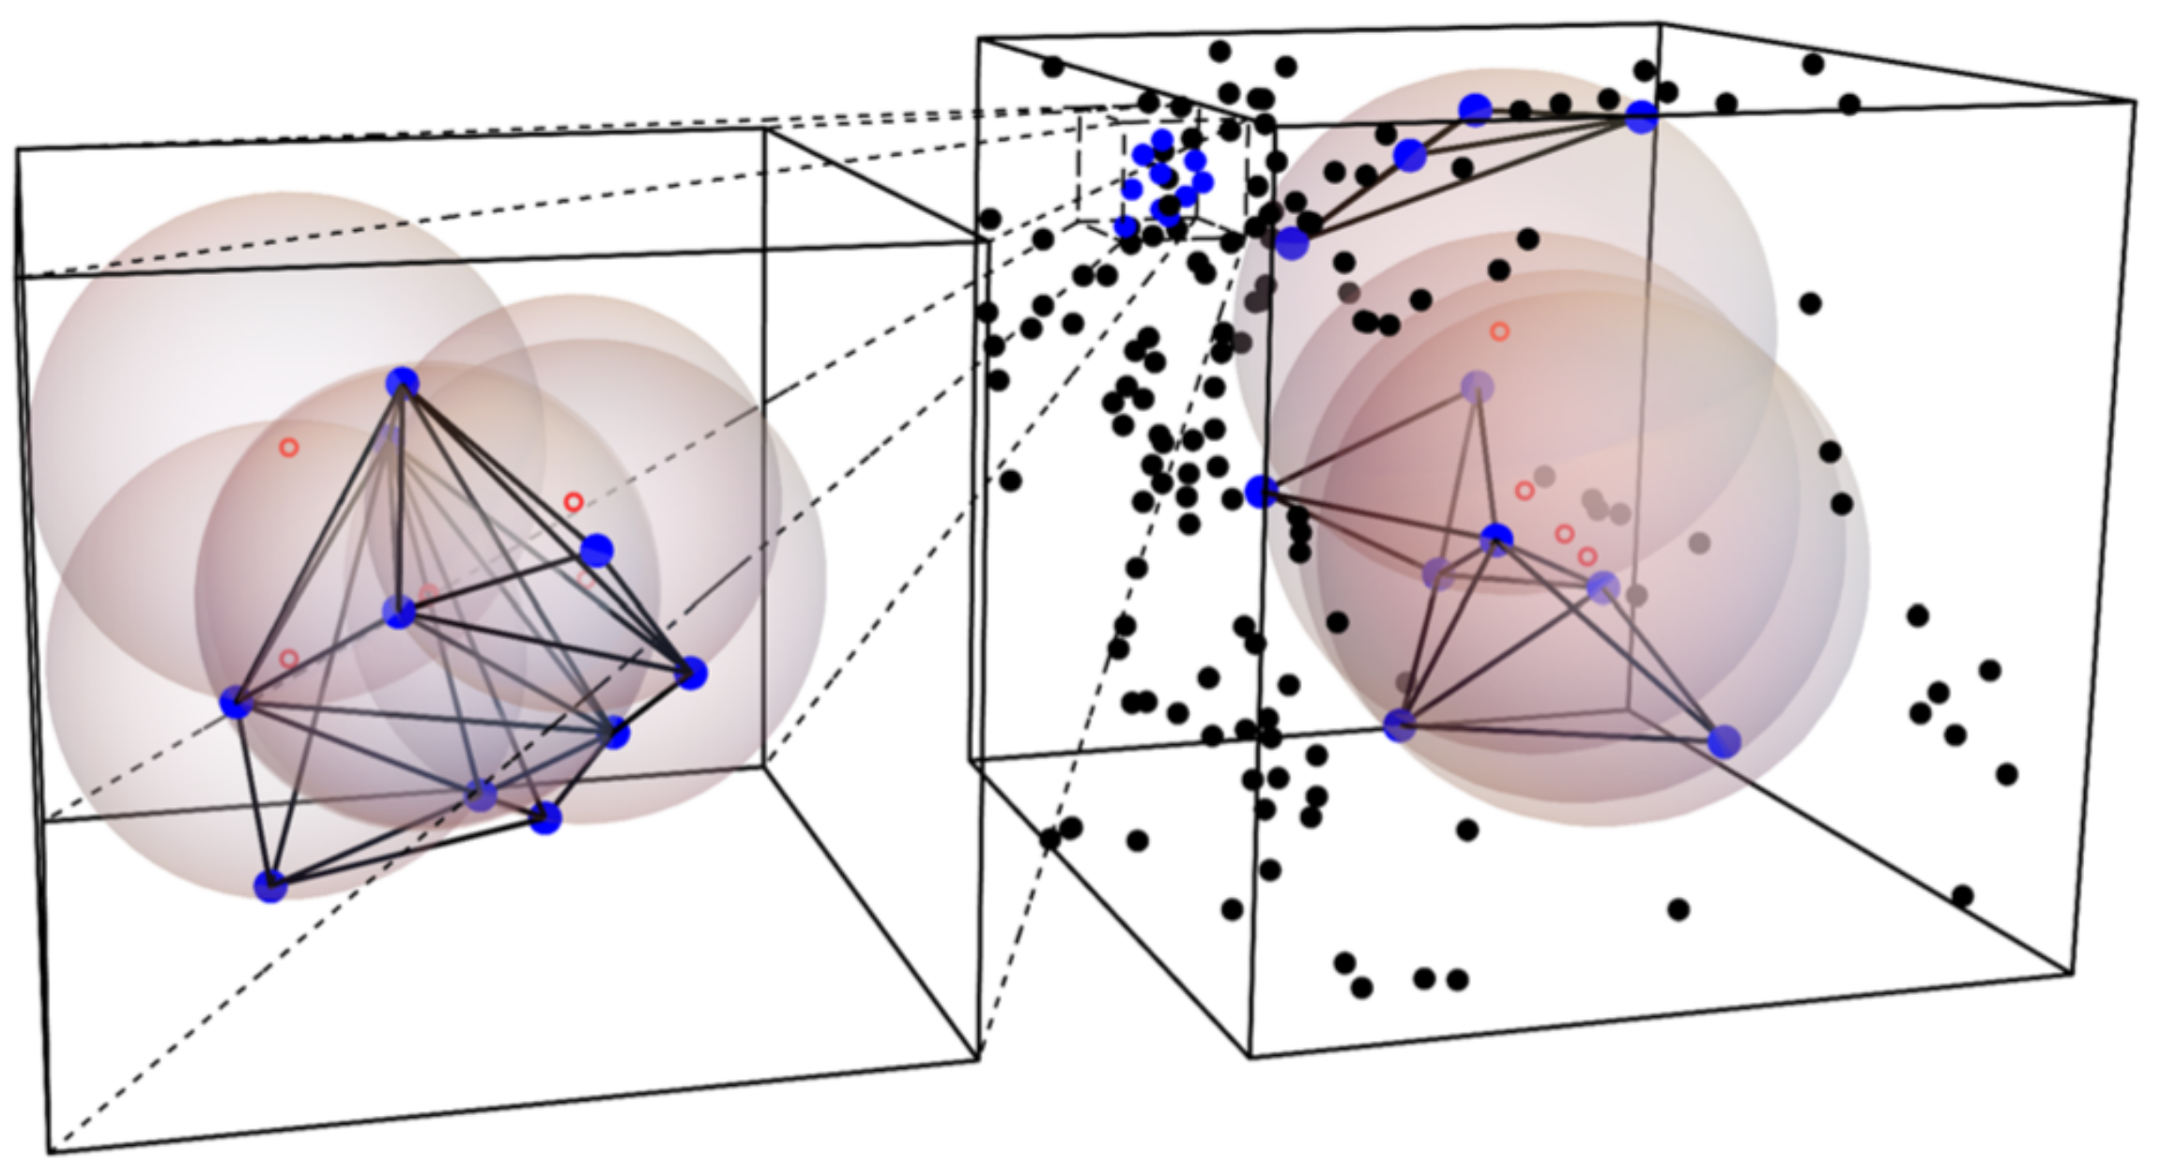
Andrei Variu
Delaunay Triangulation (DT) Voids/Spheres
Delaunay trIangulation Void findEr (DIVE) code
Circumscribing spheres of tetrahedrons
Overlapping spheres
Zhao et.al. 2016
MNRAS.459.2670Z

Slide 42
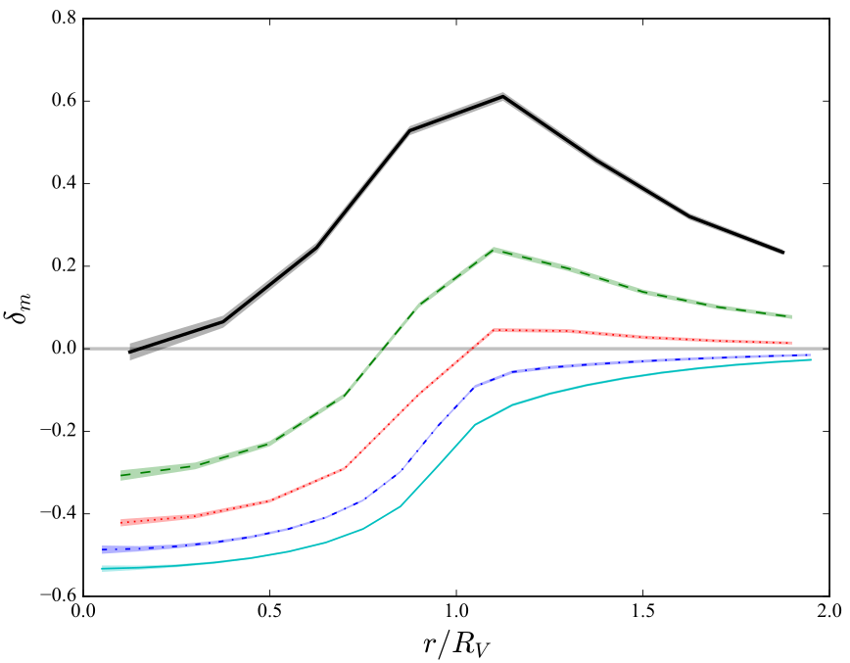
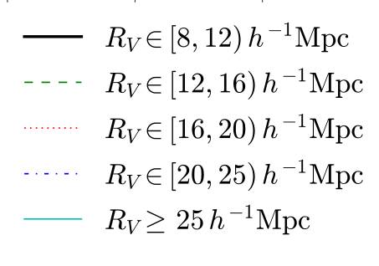
Andrei Variu
Delaunay Triangulation (DT) Voids/Spheres
Zhao et.al. 2016
MNRAS.459.2670Z
Small DT spheres - matter tracers
Large DT voids - tracers of underdense regions

Slide 43


Andrei Variu
Clustering of DT Voids
Kitaura et.al. 2016
PhysRevLett.116.171301
Kitaura et.al. 2016
PhysRevLett.116.171301

Slide 44

Andrei Variu
Clustering of DT Voids
Zhao et.al. 2019 10.1093/mnras/stz3339
the improvements are equivalent to a 20% larger sample of galaxies

Slide 45
Beyond Gaussian Fields 3-point functions
See jupyter notebook
Jonathan Blazek

Slide 46

Cheng
2-point statistics are not statistically complete...

Slide 47



Cheng
Primordial non–Gaussianity tests with the morphalogy/topology of LSS
Hikage 2008

Slide 48





Cheng
Gavity tests with voids
Cautun 2018

Slide 49



Cheng
Integrated Sachs–Wolfe (ISW) imprints of cosmic superstructures
Nadathur 2016
Kovacs 2017

Slide 50



Cheng
Graph analysis of the cosmic web (minimum spanning tree)
Naidoo 2019

